Slide 1
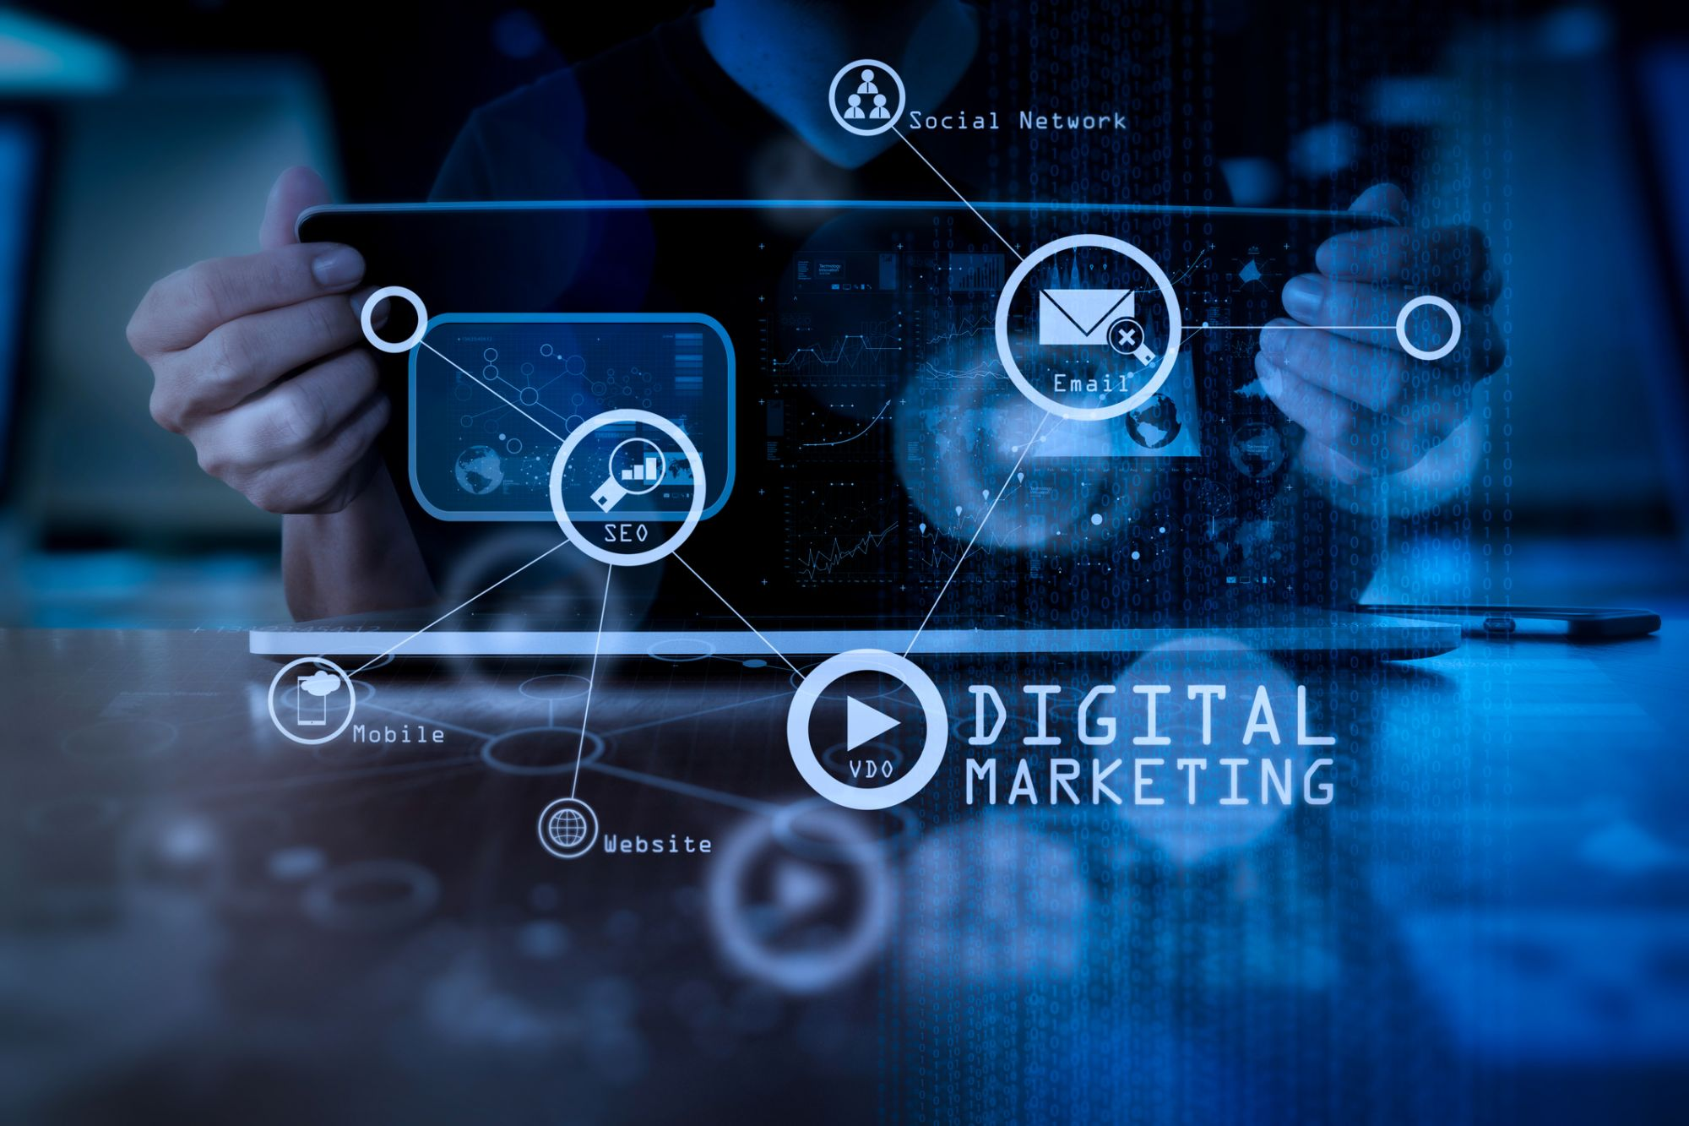

Slide 2
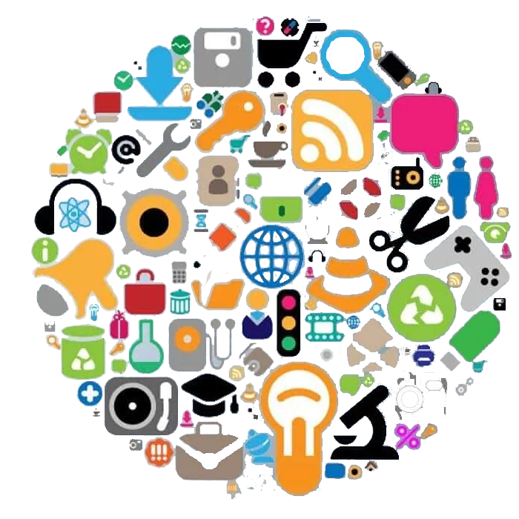
Overview of Digital Marketing

Slide 3
Digital marketing consists of several key components that work together to create an effective strategy. These include SEO, SEM, social media marketing, email marketing, and content marketing
Definition
Importance
The synergy between these components amplifies results
A cohesive approach maximizes reach, engagement, and conversions, ensuring a stronger overall strategy

Slide 4
Search Engine Optimization (SEO) is the process of optimizing a website to improve its visibility and ranking on search engine results pages (SERPs)
Search Engine Optimization (SEO)
Key Elements of SEO
1- On-Page SEO
Focuses on content quality, keyword usage, and metadata (e.g., title tags, meta descriptions)
Improves user experience and relevance to search queries
2- Off-Page SEO
Involves building backlinks from other reputable sites and leveraging social media signals to enhance authority
Boosts credibility and influence in search rankings
3- Technical SEO
Ensures your site is fast, mobile-friendly, and easily crawlable by search engine bots
Factors like site speed, mobile responsiveness, and secure HTTPS protocols are critical

Slide 5
Search Engine Marketing (SEM) refers to paid advertising efforts aimed at increasing visibility on search engine results pages through platforms like Google Ads
Search Engine Marketing (SEM)
Key Components of SEM
1. PPC (Pay-Per-Click)
Advertisers pay a fee each time their ad is clicked
Ads appear at the top or bottom of search results for targeted keywords
2- Google Ads
A platform for managing search engine ad campaigns
Enables precise targeting based on user searches, locations, and demographics
Benefits of SEM
Immediate Visibility
Quickly puts your brand in front of potential customers
Targeted Traffic
Focuses on users already searching for your product or service
Measurable ROI
Performance tracking tools show how effectively each dollar is spent

Slide 6
Social media marketing involves promoting products or services on platforms like Facebook, Instagram, Twitter, LinkedIn, and TikTok to engage users and build a brand presence
Social Media Marketing
Key Platforms
1. Facebook
Ideal for both organic posts and paid ads targeting a wide range of users
2. Instagram
Highly visual, perfect for photo and video content
3. Twitter
Great for real-time engagement and brand conversations
4. LinkedIn
Focuses on B2B marketing and professional networking
4. TikTok
Short-form video content, popular with younger audiences
Strategies
Organic Content
Regular posts, stories, and engagement with followers
Paid Ads
Target specific demographics with promoted posts
Influencer Partnerships
Collaborating with influencers to expand reach

Slide 7
Social Media Marketing
(contd…)
Benefits
Brand Awareness
Increase visibility and recognition
Customer Engagement
Interact directly with your audience and foster loyalty
Lead Generation
Turn followers into paying customers

Slide 8
Email marketing is a strategy for sending targeted messages directly to a list of subscribers, aiming to engage them and drive conversions
Email Marketing
Key Elements
1. Building an Email List
Use lead magnets (e.g., free eBooks, webinars) to encourage sign-ups
Ensure you have permission-based subscribers
2. Segmentation
Divide your email list into segments based on user behavior, demographics, or interests
Send personalized content to specific segments for higher engagement
3. Campaign Types
Newsletters
Regular updates on company news, blog posts, or announcements
Promotional Emails
Drip campaigns or welcome emails triggered by user actions

Slide 9
Email Marketing
(contd…)
Benefits
High ROI
One of the most cost-effective marketing strategies
Personalization
Tailor messages to specific user segments
Measurable Results
Track open rates, click-through rates, and conversions easily

Slide 10
Content marketing focuses on creating and distributing valuable, relevant content to attract, engage, and retain a target audience
Content Marketing
Types of Content
Blog Posts
In-depth articles that provide value to your audience
Videos
Engaging visual content that conveys your message effectively
Infographics
Engaging visual content that conveys your message effectively
Podcasts
Audio content that can reach users on the go
Social Media Content
Short-form posts, stories, and updates across platforms
Key Strategies
Story Telling
Connect with your audience emotionally through compelling narratives
SEO-Optimized Content
Ensure your content ranks well on search engines
Sharing on Social Media
Amplify your content’s reach by sharing across social channels

Slide 11
Content Marketing
Benefits
Builds Brand Authority
Establish your brand as an industry leader
Drives Traffic
High-quality content attracts visitors to your site
Enhances Customer Loyalty
Keeps your audience engaged with valuable information

Slide 12
Integrating the Components
How Components Work Together
Example
SEO drives organic traffic to a website, which can then be leveraged in email marketing campaigns to convert visitors into customers
Creating a Cohesive Strategy
Align Messaging Across Channels
Ensure that your brand’s message is consistent across all digital marketing components
Use Data to Inform Other Components
Insights from social media can guide content creation, while email metrics can inform SEO strategies

Slide 13
Discussion Questions
Which component do you think is the most critical for a successful digital marketing strategy? Why?
(Encourage students to share their views on the relative importance of SEO, SEM, social media, email, and content marketing.)
Have you encountered any effective digital marketing campaigns that utilized multiple components?
(Ask students to provide examples and analyze how different components worked together.)

Slide 14


Slide 15


